Slide 1
control logic design
By Tahseen Asma Meem

Slide 2
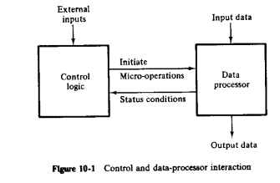
introduction
The data processor part may be a general purpose processor unit or it may consist of individual registers and associated digital functions. The control logic initiates all micro-operations in the data processor. The control logic is a sequential circuit whose internal states dictate the control functions for the system by generating the signals for sequencing the micro-operations.
Methods of Control Organization
One flip-flop per state method
Sequence register and decoder method
PLA control
Microprogram control
The first two method must use SSI and MSI circuits for the implementations.
PLA or microprogram uses an LSI device.

Slide 3
Microprogram control
The purpose of the control unit is to initiate a series of sequential steps of micro-operations.
A control unit whose control variables are stored in a memory is called a microprogrammed control unit.
Each control word of memory is called a microinstruction.
A sequence of microinstructions is called a microprogram.

Slide 4
Hard wired control example
The design is carried out in five consecutive steps
The problem is stated
An initial equipment configuration is assumed
An algorithm is formulated
The data-processor part is specified
The control logic is designed

Slide 5
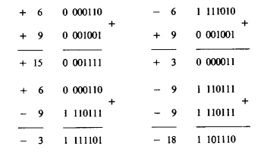
1) Statement of the problem
The statement here is to implement with hardware the addition and subtraction of binary fixed point numbers represented in sign magnitude form.
The addition of two numbers stored in registers of finite length may result in a sum that exceeds the storage capacity of the register by one bit.
The extra bit is said to cause an overflow. The circuit must provide a flip-flop for storing a possible overflow bit.

Slide 6
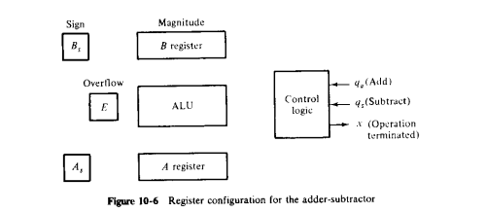
2) Equipment configuration
The two signed binary numbers to be added or subtracted contain n bits. The magnitudes of the numbers contain k=n-1 bits and are stored in registers A and B. The sign bits are stored in flip-flops As and Bs.
The ALU performs the arithmetic operations and the 1-bit register E serves as the overview flip-flop. The output carry from the ALU is transferred to E.
Two input signals in the control specify the add (qa) and subtract (qs) operations. Output variable x indicates the end of the operation.

Slide 7
3) Derivation of algorithm
When the numbers are added or subtracted algebraically, there are eight different conditions to be consider and may be expressed as compact form as follows:
In arithmetic operation specified in subtraction, we change the sign of B and add. So the relationships :
This reduce the number of possible conditions to four, namely:
When the signs of A and B are the same, we add the two magnitudes and the sign of the result in the same as the common sign.
When the sign of A and B are not same, we subtract the smaller number from the larger and the sign of the result is the sign of the larger number.

Slide 8
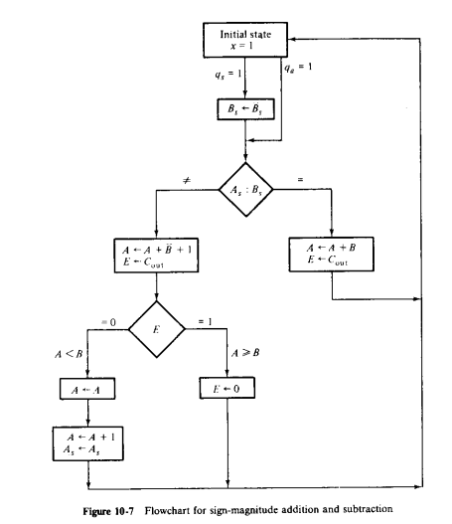
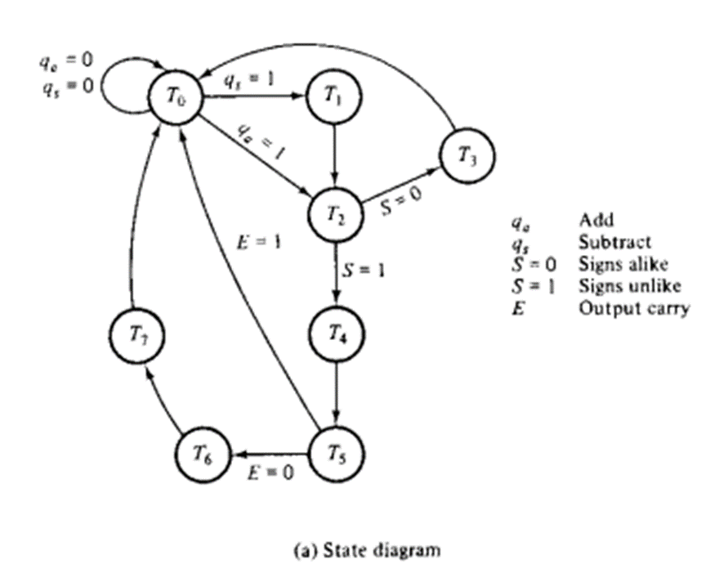
3) Flowchart for sign magnitude addition and subtraction

Slide 9
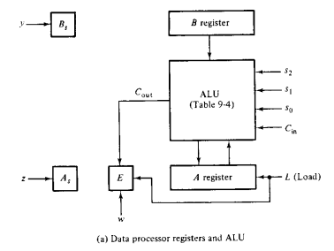
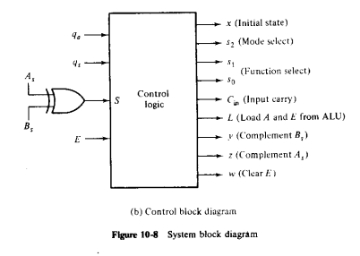
4) Data processor register
5)control block diagram
The control receives five inputs: two form the external environment and three from the data processor.
To simplify the design we define a new variable S: S = As xor Bs
The operations between A and B can be done with the ALU.
The operations with As, Bs and E must be initiated with separate control variables.

Slide 10
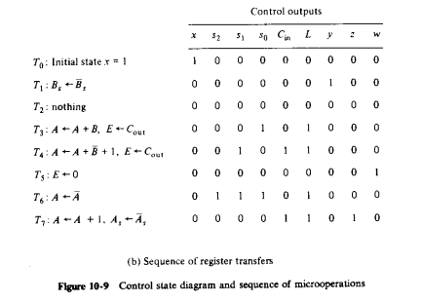

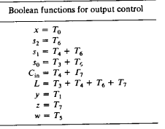
5)control block diagram
For relating the control outputs, have a look to the next slide.

Slide 11
For reference :
Table:
Binary Code |  |  | Function of selection variables
 | B | A | F with C_{in} = 0 | F with C_{in} = 1 | D | H
0 0 0 | Input Data | Input Data | A | A+1 | None | Circulate-Left with Carry
0 0 1 | R1 | R1 | A+B | A+B+1 | R1 | Circulate-Right with Carry
0 1 0 | R2 | R2 | A+B` | A+B`+1 | R2 | No shift
0 1 1 | R3 | R3 | A-1 | A | R3 | 0’s to the output Bus
1 0 0 | R4 | R4 | A OR B | A OR B | R4 | -
1 0 1 | R5 | R5 | A XOR B | A XOR B | R5 | Shift Left with I_{L}=0
1 1 0 | R6 | R6 | A AND B | A AND B | R6 | Shift Right with I_{R}=0
1 1 1 | R7 | R7 | A′ | A′ | R7 | 1’s to the output Bus

